Slide 1

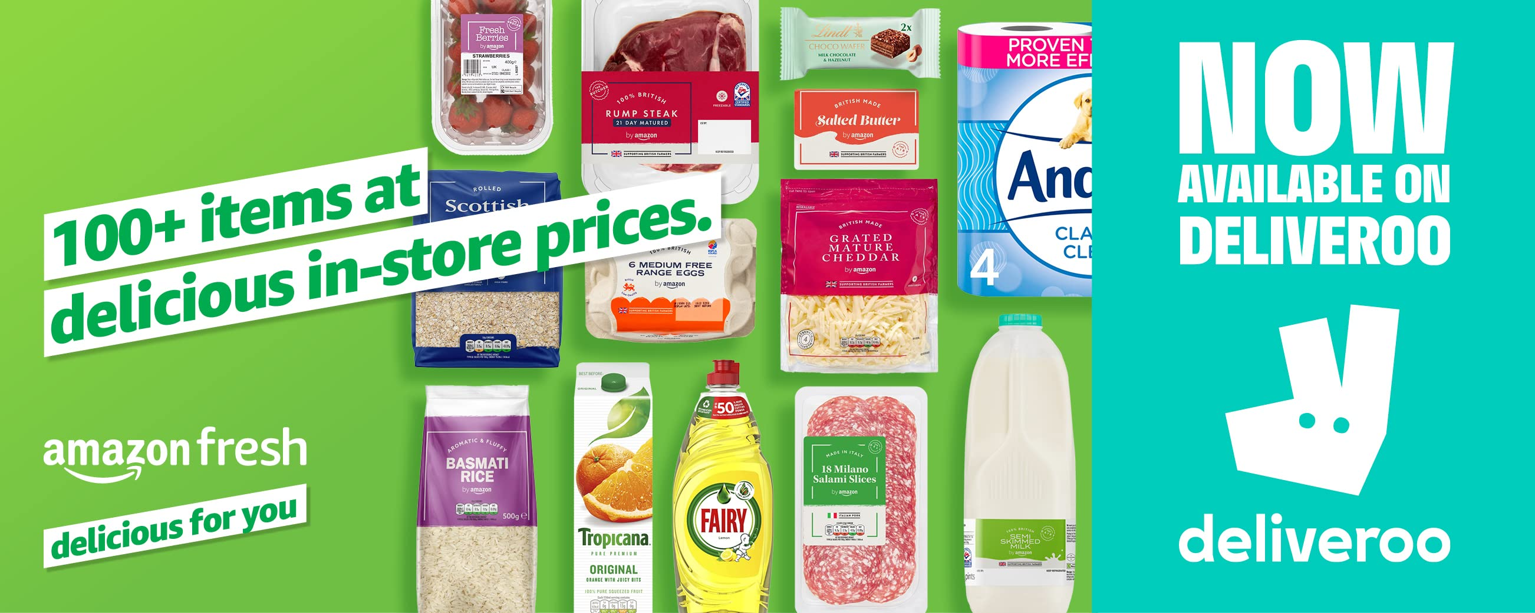

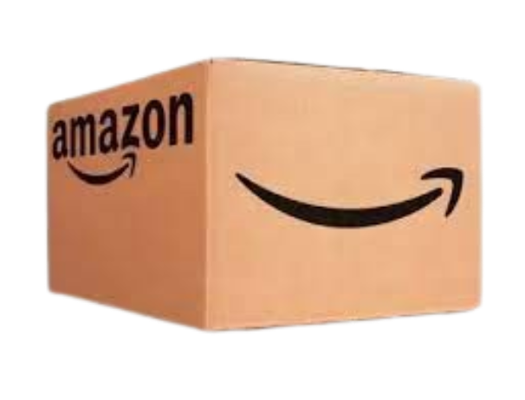
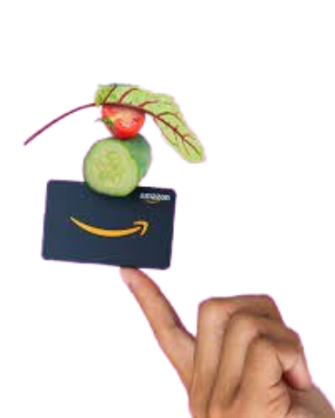
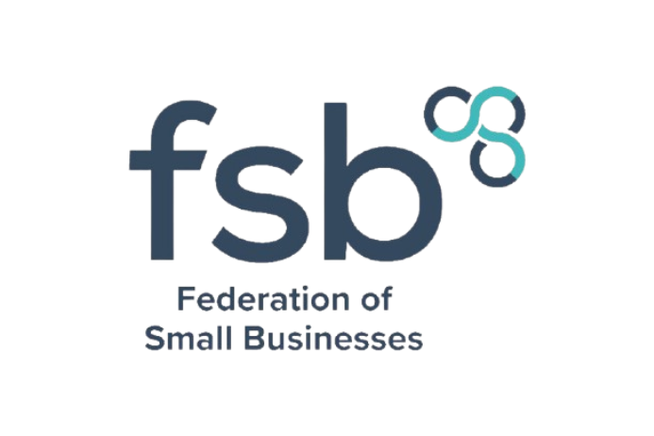
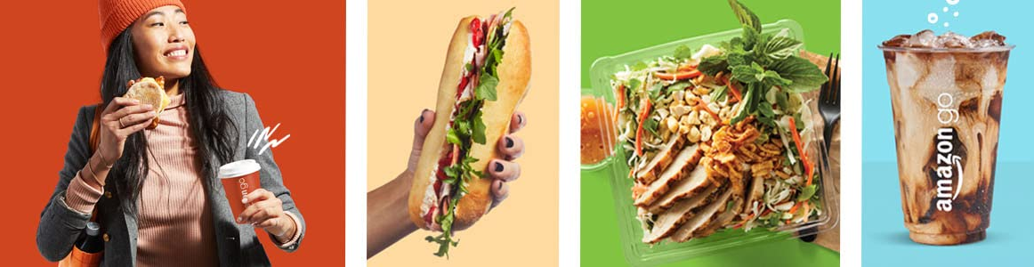

CONTENT
Strategic Marketing Insights for Local Businesses: Lessons from
Federation of Small Businesses (FSB) UK
NAME

Slide 2
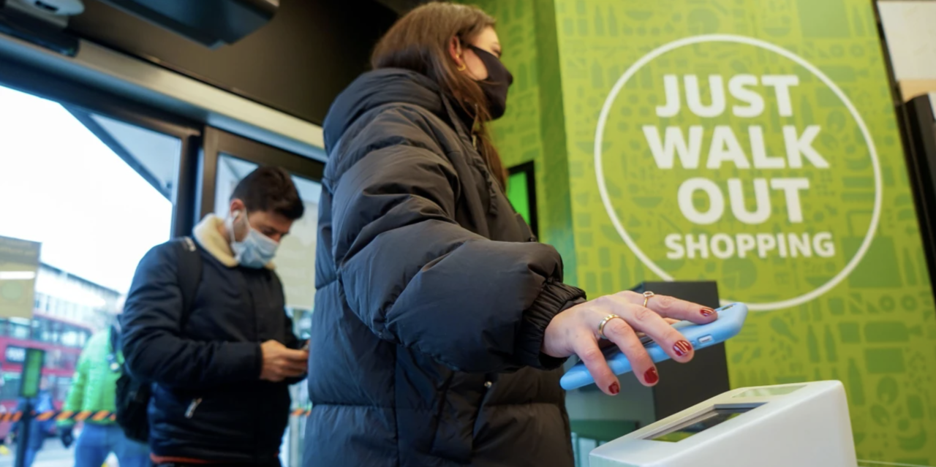

Introduction
CONTENT
1. Introduction to Strategic Marketing
2. The Marketing Planning Process
3. Key Marketing Concepts and Theories
4. Product Lifecycle and Marketing Mix
5. The Significance of Branding
6. Brand Pyramid, Positioning, and Management
7. Integration of Branding Concepts into Marketing Planning
8. Recommendations for FSB UK Members
9. Conclusion

Slide 3
2. Marketing Planning Process
1.Introduction to Strategic Marketing
Definition of Strategic Marketing: Strategic marketing is the process of planning, developing, and executing marketing initiatives that align with an organization’s long-term goals, ensuring that customer needs are met effectively while achieving competitive advantage.
Purpose of Strategic Marketing in an Organization:
Aligns Business Objectives with Customer Needs:
Ensures products/services fulfill market demands.
Example: Amazon Go's focus on convenience for busy urban professionals.
Drives Competitive Advantage:
Differentiates the business from competitors.
Example: Amazon Go’s innovative "Just Walk Out" technology creates a unique retail experience.
Enables Long-Term Business Growth and Sustainability:
Encourages customer retention and loyalty.
Example: By solving the pain point of long queues, Amazon Go builds trust and a loyal customer base.
Notes:
Example – Amazon Go: Amazon Go exemplifies strategic marketing by leveraging cutting-edge technology (computer vision, AI, and sensor fusion) to redefine convenience in the retail sector. This innovation-driven approach enhances customer experience and positions Amazon as a leader in modern retail.

Slide 4
2. Marketing Planning Process
Situational Analysis (SWOT, PESTLE).
Setting Objectives.
Strategy Development (STP: Segmentation, Targeting, Positioning).
Tactical Implementation (Marketing Mix).
Monitoring and Evaluation.

Slide 5
2. Marketing Planning Process
Situation Analysis:
SOWT
Category | Details | Amazon Go Example
Strengths | Internal advantages that provide a competitive edge. | Innovative "Just Walk Out" technology, strong brand reputation (Amazon).
Weaknesses | Internal limitations or challenges. | High implementation costs, technical issues with crowd management.
Opportunities | External factors that can be leveraged for growth. | Expanding into urban markets, increasing demand for convenience shopping.
Threats | External challenges that could hinder success. | Competition from local supermarkets, regulatory hurdles in new markets.
Setting Objectives.
Strategy Development
Implementation
Monitoring and Evaluation.
Notes:
Explanation:
Strengths: Amazon Go leverages Amazon's strong brand and cutting-edge technology to provide an unmatched shopping experience. The system’s seamless operation, driven by sensors and AI, is a clear advantage.
Weaknesses: Despite the technological innovations, Amazon Go’s reliance on advanced technology for store operations comes with high costs, and its current reach is limited compared to traditional retailers.
Opportunities: There’s potential for Amazon Go to grow by opening more stores, expanding globally, and exploring partnerships for tech integration with other businesses, catering to the increasing demand for urban convenience.
Threats: While Amazon Go is a leader in tech-driven shopping, it faces stiff competition from well-established retailers and potential risks from technical issues that could harm its brand reputation.

Slide 6
2. Marketing Planning Process
Situation Analysis:
PESTLE
Factor | Details | Amazon Go Example
Political | Government policies, trade regulations, and political stability. | Regulatory compliance in the UK for cashier-less operations.
Economic | Economic trends, inflation, and consumer purchasing power. | Economic growth in urban areas supports premium convenience services.
Social | Societal trends, demographics, and cultural attitudes. | Growing demand for fast, queue-free shopping among busy professionals.
Technological | Innovations, R&D, and advancements in technology. | Use of computer vision, AI, and sensor fusion for a seamless experience.
Legal | Laws, regulations, and compliance requirements. | Data privacy laws and liability for technological failures.
Environmental | Sustainability and environmental considerations. | Reducing waste with efficient inventory and supply chain systems.
Setting Objectives.
Strategy Development
Implementation
Monitoring and Evaluation.
Notes:
Explanation:
Strengths: Amazon Go leverages Amazon's strong brand and cutting-edge technology to provide an unmatched shopping experience. The system’s seamless operation, driven by sensors and AI, is a clear advantage.
Weaknesses: Despite the technological innovations, Amazon Go’s reliance on advanced technology for store operations comes with high costs, and its current reach is limited compared to traditional retailers.
Opportunities: There’s potential for Amazon Go to grow by opening more stores, expanding globally, and exploring partnerships for tech integration with other businesses, catering to the increasing demand for urban convenience.
Threats: While Amazon Go is a leader in tech-driven shopping, it faces stiff competition from well-established retailers and potential risks from technical issues that could harm its brand reputation.

Slide 7
2. Marketing Planning Process
Setting Objectives.
Objective | Description | Measurable KPI | Timeframe | Example (Amazon Go)
Streamline Shopping Experience | Enhance customer convenience by eliminating checkout lines. | Reduction in average time spent in-store per customer. | 1 year | Implement "Just Walk Out" technology in all stores.
Expand into Urban Markets | Increase Amazon Go presence in major UK cities. | Number of new stores opened in the UK. | 2 years | Open 10 stores in major UK cities (e.g., London, Manchester).
Increase Customer Adoption | Drive higher customer engagement and usage of the Amazon Go app. | Growth in app downloads and active users. | 6 months | Achieve 1 million active users for Amazon Go app in the UK.
Improve Operational Efficiency | Optimize store operations for better inventory and cost management. | Reduction in operational costs per store. | 1 year | Reduce inventory management costs by 15%.
Enhance Brand Recognition | Build Amazon Go’s brand as a leader in cashier-less retail technology. | Increase in brand awareness and media mentions. | 1 year | Achieve a 30% increase in media mentions of Amazon Go.
Situation Analysis
Strategy Development
Implementation
Monitoring and Evaluation.
Notes:
Explanation:
Segmentation: Amazon Go segments its market based on demographics (targeting young, professional individuals) and behavior (customers who value convenience and efficiency).
Targeting: Amazon Go targets busy professionals and tech-savvy consumers who need a frictionless shopping experience. This target group includes urban individuals with a high need for time-saving solutions.
Positioning: Amazon Go positions itself as a cutting-edge, innovative solution for busy, modern consumers looking for an effortless and quick shopping experience.

Slide 8
2. Marketing Planning Process
Strategy Development
STP Component | Description | Amazon Go Example
Segmentation | Identifying distinct groups of customers based on various factors like demographics, behaviors, and needs. | Customers can be segmented based on: - Demographics: Age (millennials), Occupation (urban professionals). - Behavioral: Customers who value convenience and time savings.
Targeting | Focusing on high-potential segments by aligning marketing efforts with the most promising customer groups. | High-Potential Segments for Amazon Go: - Busy Professionals: Urban workers seeking quick shopping solutions. - Tech-Savvy Consumers: Individuals interested in innovative technologies.
Positioning | Differentiating the brand in the minds of the target audience by highlighting unique value propositions. | Amazon Go Positioning: - Convenience: Emphasizing quick, hassle-free shopping without waiting in line. - Technology-Driven Innovation: Using advanced "Just Walk Out" technology for a seamless experience. - Premium Experience: Positioning as a modern, high-tech shopping experience for busy individuals.
Situation Analysis
Setting Objectives.
Implementation
Monitoring and Evaluation.
Notes:
Explanation:
Product: Amazon Go offers a wide range of ready-to-eat meals and everyday essentials, ensuring a convenient shopping experience with a tech-driven, checkout-free process.
Price: Amazon Go uses competitive pricing to attract customers while positioning itself as an affordable and convenient shopping option. The pricing is designed to match the urban lifestyle of busy professionals.
Place: Amazon Go strategically places its stores in high-traffic urban areas such as near offices and busy shopping streets to reach its target audience. This also enhances accessibility and convenience.
Promotion: The promotional strategy revolves around leveraging technology, such as in-app discounts, Amazon Prime membership integration, and digital marketing campaigns to reach customers and drive store visits.

Slide 9
2. Marketing Planning Process
Implementation
Marketing Mix Element | Description | Amazon Go Example
Product | The goods or services offered to meet customer needs. | - Ready-to-eat meals, snacks, and essential groceries.
Price | The pricing strategy used to ensure the product is perceived as valuable by the target market. | - Competitive pricing, similar to local supermarkets, with a premium for the tech-enabled shopping experience.
Place | The distribution channels used to make the product available to customers. | - Strategically placed stores in urban, high-traffic areas (e.g., central business districts, near transportation hubs). .
Promotion | The methods used to communicate the product's value proposition to the target audience. | - Digital marketing campaigns focusing on the convenience of "Just Walk Out" technology.
Situation Analysis
Setting Objectives.
Marketing Mix Decisions
Monitoring and Evaluation.
Notes:
Explanation:
Store Openings: Amazon Go opens stores in high-traffic locations to maximize footfall and make it convenient for busy consumers to access the service.
App Functionality: The app is a core part of the seamless experience, ensuring that customers can easily track their purchases and avoid checkout lines.
Technology Integration: Advanced technologies such as AI and sensors are critical for optimizing the store’s automated shopping process.
Staff Training: Proper staff training ensures that employees can assist customers in case of technical issues and maintain a smooth experience.
Customer Education: Educating customers on how the Amazon Go system works encourages adoption and enhances satisfaction.
Partnerships: Partnerships with local businesses help Amazon Go to promote its stores through location-based offers.
Feedback Collection: Continuous feedback helps improve the store experience and ensures that Amazon Go remains responsive to customer needs

Slide 10
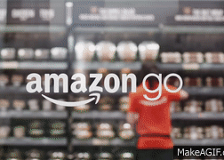
3. Key Marketing Concepts and Theories
2. Marketing Planning Process
Monitoring and Evaluation.
Monitoring & Evaluation Element | Description | Amazon Go Example
KPIs (Key Performance Indicators) | Metrics used to measure the success of marketing strategies and the achievement of objectives. | - Foot traffic: Number of customers visiting Amazon Go stores daily. -
Customer Feedback | Gathering insights from customers to evaluate their experience and improve services. | - Collecting real-time feedback via in-app surveys and direct reviews.
Adjusting Marketing Strategies | Adapting marketing tactics and strategies based on performance data and feedback. | - Modifying digital campaigns based on customer behavior patterns and engagement rates.
Store Expansion Monitoring | Tracking the progress and success of new store openings and expansions. | - Analyzing the performance of new locations through sales data and customer engagement metrics. .
Situation Analysis
Setting Objectives.
Marketing Mix Decisions
Implementation
Impact of Competitive Forces in the Retail Industry:
Threat of New Entrants: High, as new technology and cashier-less systems like Amazon Go make it easier for others to enter the retail space with lower overhead costs.
Bargaining Power of Suppliers: Relatively low in Amazon Go's case, as it leverages its technology to create efficiencies and partnerships with product suppliers.
Bargaining Power of Consumers: High, with the convenience-driven customers having many alternatives, but Amazon Go’s innovation keeps them loyal.
Threat of Substitute Products: High, as there are alternative shopping methods such as traditional stores, other tech-based systems, and online shopping.
Industry Rivalry: High, with major competitors like Tesco, Sainsbury’s, and other retailers trying to innovate in response to Amazon Go’s success.
Notes:
Explanation:
Store Performance Monitoring: Continuous tracking of sales and customer traffic provides insights into store success and areas needing attention, helping Amazon Go optimize store operations.
Customer Feedback Analysis: Regular feedback collection allows Amazon to make real-time improvements based on customer input, enhancing satisfaction and loyalty.
Technology Monitoring: Keeping an eye on the technology performance ensures that the AI and sensor systems are functioning properly, preventing disruptions in the shopping experience.
Competitive Analysis: Understanding what competitors are doing helps Amazon Go stay ahead of industry trends and make informed adjustments.
KPI Evaluation: KPIs such as customer satisfaction and retention rates offer quantifiable measures of how well the strategy is working.
Market Trend Analysis: Staying aware of evolving market trends allows Amazon Go to adjust its strategy in response to changing consumer preferences.
Adjustment and Optimization: Regular strategic adjustments ensure the company remains agile, making necessary changes based on real-time data and feedback.

Slide 11
3. Key Marketing Concepts and Theories
Impact of Competitive Forces in the Retail Industry:
Threat of New Entrants: High, as new technology and cashier-less systems like Amazon Go make it easier for others to enter the retail space with lower overhead costs.
Bargaining Power of Suppliers: Relatively low in Amazon Go's case, as it leverages its technology to create efficiencies and partnerships with product suppliers.
Bargaining Power of Consumers: High, with the convenience-driven customers having many alternatives, but Amazon Go’s innovation keeps them loyal.
Threat of Substitute Products: High, as there are alternative shopping methods such as traditional stores, other tech-based systems, and online shopping.
Industry Rivalry: High, with major competitors like Tesco, Sainsbury’s, and other retailers trying to innovate in response to Amazon Go’s success.
Example: Amazon Go shifts the paradigm of traditional shopping by eliminating checkout queues and enabling a frictionless shopping experience, challenging conventional brick-and-mortar stores.

Slide 12



3. Key Marketing Concepts and Theories
The STP Model (Segmentation, Targeting, Positioning)
Segmentation:
Amazon Go targets urban, busy professionals who value time-saving solutions in their daily lives. Customers are often tech-savvy individuals, professionals, and commuters in metropolitan areas.
Targeting:
Amazon Go specifically targets time-sensitive individuals in high-density areas such as city centers, office districts, and transit hubs. These consumers are looking for a quick, efficient shopping experience.
Positioning:
Convenience and Innovation: Amazon Go positions itself as a high-tech, frictionless shopping experience that eliminates traditional pain points like long checkout lines, enabling customers to “Just Walk Out” after selecting products.
Marketing Mix Element | Description | Example (Amazon Go)
Product | Ready-to-eat meals and essential groceries for busy individuals. | Quick, convenient shopping with curated food and grocery options for time-sensitive consumers.
Price | Competitive pricing with a premium for convenience. | Affordable pricing with added value for the "Just Walk Out" experience.
Place | High-traffic, urban locations like offices and transportation hubs. | Stores in downtown areas, near offices, and transit stations for easy access.
Promotion | Digital campaigns highlighting innovative shopping technology. | Social media and app-based promotions showcasing the seamless experience and time-saving benefits.
People | Minimal staff with tech support available to ensure smooth customer experiences. | Tech support available for troubleshooting while ensuring a staff-less, seamless shopping process.
Process | Fully automated shopping driven by advanced AI and sensors. | "Just Walk Out" technology tracks items without manual scanning or checkouts.
Physical Evidence | Futuristic store design showcasing Amazon's technological capabilities. | High-tech store layout providing a modern, innovative shopping experience.

Slide 13
3. Key Marketing Concepts and Theories
The 7Ps Marketing Mix for Amazon Go
Marketing Mix Element | Description | Example (Amazon Go)
Product | Ready-to-eat meals and essential groceries for busy individuals. | Quick, convenient shopping with curated food and grocery options for time-sensitive consumers.
Price | Competitive pricing with a premium for convenience. | Affordable pricing with added value for the "Just Walk Out" experience.
Place | High-traffic, urban locations like offices and transportation hubs. | Stores in downtown areas, near offices, and transit stations for easy access.
Promotion | Digital campaigns highlighting innovative shopping technology. | Social media and app-based promotions showcasing the seamless experience and time-saving benefits.
People | Minimal staff with tech support available to ensure smooth customer experiences. | Tech support available for troubleshooting while ensuring a staff-less, seamless shopping process.
Process | Fully automated shopping driven by advanced AI and sensors. | "Just Walk Out" technology tracks items without manual scanning or checkouts.
Physical Evidence | Futuristic store design showcasing Amazon's technological capabilities. | High-tech store layout providing a modern, innovative shopping experience.

Slide 14
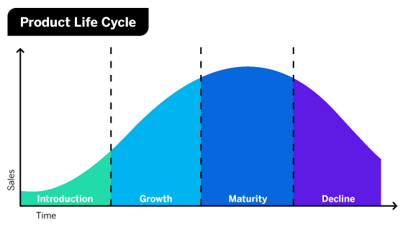
5: Product Lifecycle and Marketing Mix
Introduction Stage:
The product is launched, requiring significant investment in marketing and education. Focus is on building awareness and encouraging trial.
Growth Stage:
Sales increase as the product gains acceptance.
Marketing efforts shift towards differentiation and expanding the customer base.
Maturity Stage:
Growth slows, and competition intensifies.
Emphasis is on retaining market share and improving efficiency.
Decline Stage:
Sales decrease due to market saturation or new innovations.
Strategies may include product discontinuation or niche targeting

Slide 15
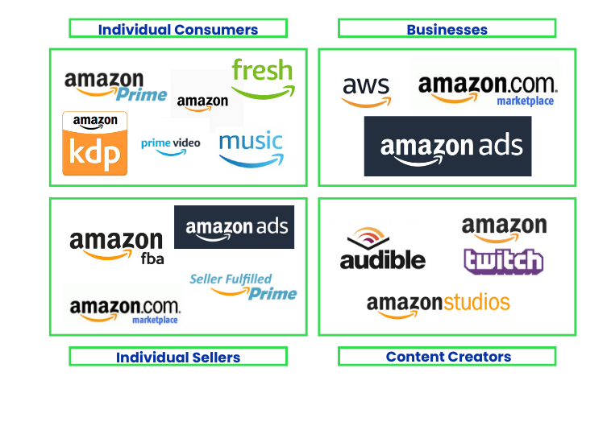
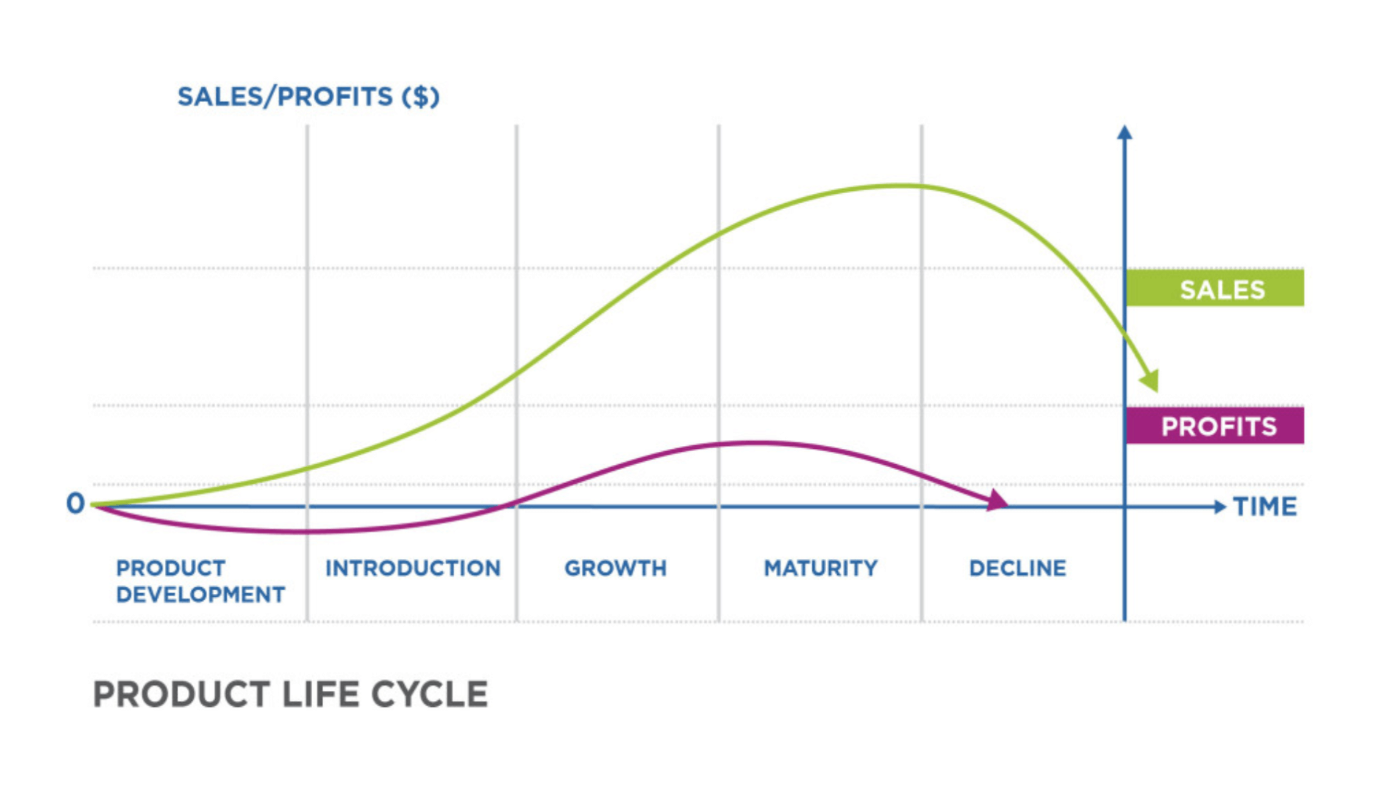
5: Product Lifecycle and Marketing Mix
Amazon Go Example in Product Lifecycle
Introduction Stage:
Heavy investment in "Just Walk Out" technology development.
Promotion focuses on educating customers about cashier-less shopping.
Growth Stage:
Expansion to multiple urban locations.
Refined product offerings based on consumer preferences.
Maturity Stage:
Increased efficiency in operations.
Loyalty programs and targeted marketing strategies to retain customers
(Rubin, 2017)
Nature of Brands
A brand embodies trust, quality, and value, acting as a promise to customers.
Strong branding influences customer perceptions and drives loyalty.
Example:
Amazon is synonymous with innovation, reliability, and exceptional customer experience.
Its sub-brand, Amazon Go, extends this by redefining retail through cutting-edge technology.

Slide 16

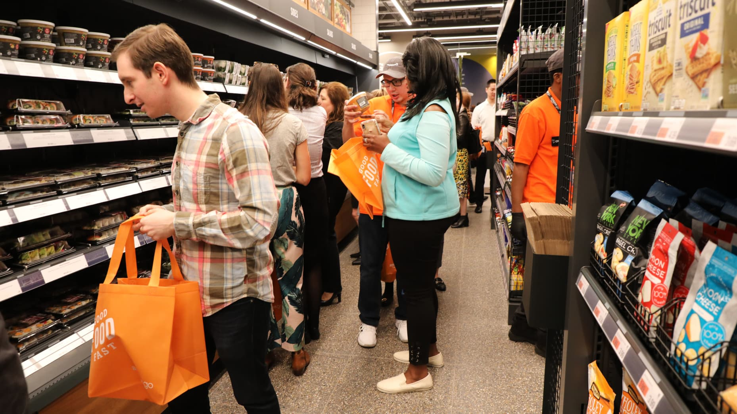
5. The Significance of Branding
Nature of Brands
A brand embodies trust, quality, and value, acting as a promise to customers.
Strong branding influences customer perceptions and drives loyalty.
Example:
Amazon is synonymous with innovation, reliability, and exceptional customer experience.
Its sub-brand, Amazon Go, extends this by redefining retail through cutting-edge technology.

Slide 17
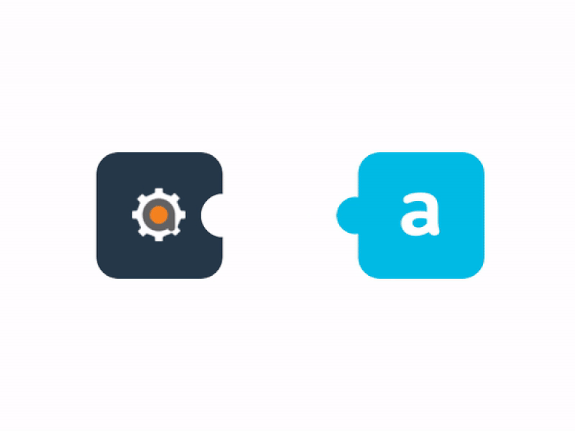
6. Brand Pyramid, Positioning, and Management
Significance of Branding
Customer Loyalty: Strong branding fosters trust and long-term customer relationships.
Market Differentiation: Distinguishes products and services in competitive environments.
Value Addition: Increases perceived value, enabling premium pricing and better customer retention.

Slide 18
7. Integration of Branding Concepts into Marketing Planning
Importance of Integration
Consistency: Delivers uniform messaging across all platforms, building trust and recognition.
Enhanced Customer Experience: Aligns branding with customer expectations for seamless interaction.
Alignment with Goals: Ensures branding supports organizational vision and objectives.

Slide 19
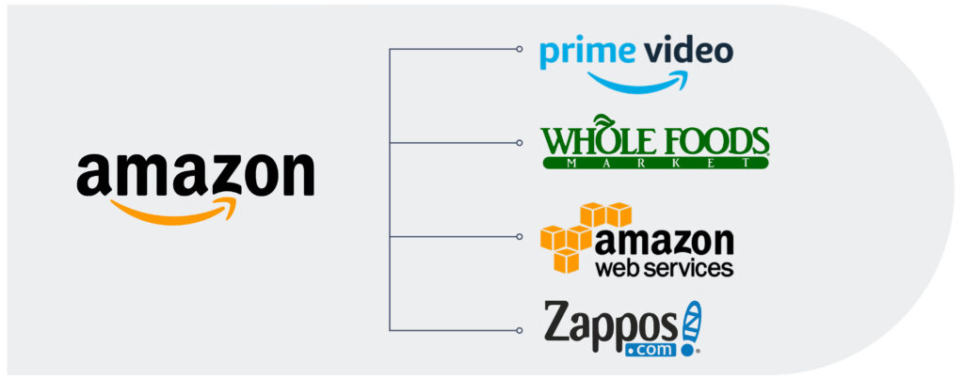
7. Integration of Branding Concepts into Marketing Planning
Application to Local Businesses
Leverage technology to enhance branding efforts (e.g., personalized customer experiences).
Adopt Amazon’s customer-centric approach to create strong, relatable, and innovative brand identities.

Slide 20

8. Recommendations for FSB UK Members
Embrace Technology
Utilize digital tools to improve convenience and operational efficiency.
Example: Implement seamless customer experiences inspired by Amazon Go’s "Just Walk Out" technology.
Focus on Strategic Marketing
Align business objectives with evolving customer needs.
Conduct regular market research to stay competitive.
Leverage Branding
Differentiate offerings by highlighting unique value propositions.
Foster customer loyalty through consistent, trust-building branding efforts.

Slide 21

9. Conclusion
Summary of Key Points
Strategic marketing aligns business goals with customer needs, driving growth and competitiveness.
The marketing planning process, branding, and technology integration are essential for success.
Real-world examples like Amazon Go highlight the impact of innovation and customer-centric strategies.

Slide 22
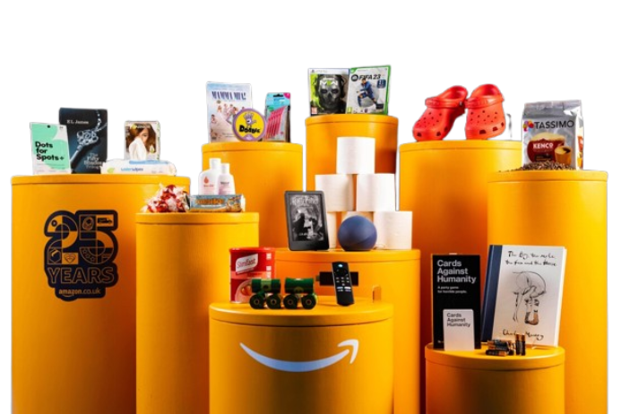
10. References
Armstrong, G., & Kotler, P. (2017). Marketing: An Introduction (13th ed.). Pearson Education.
Porter, M. E. (2008). The Five Competitive Forces That Shape Strategy. Harvard Business Review, 86(1), 78-93. https://doi.org/10.1016/j.jom.2008.08.002
Kotler, P., & Keller, K. L. (2016). Marketing Management (15th ed.). Pearson Education.
Amazon. (2023). Amazon Go: Just Walk Out Technology. https://www.amazon.com/go
West, D. (2018). The 7Ps of Marketing: A Comprehensive Guide. Journal of Marketing Science, 45(4), 102-115. https://doi.org/10.1177/0149206317745971
PESTLE Analysis. (2023). PESTLE Analysis Framework. https://www.pestleanalysis.com
Cliffe, S. (2017). The Future of Retail: Amazon Go and the Impact of Automation. The Retail Journal, 29(3), 45-50.
Marketing Week. (2019). How Amazon is Revolutionizing Retail with Technology. Marketing Week. https://www.marketingweek.com/amazon-revolutionizing-retail

Slide 23
CONTENT
THANK YOU
NAME

